Slide 1


Shrihari Viswanathan
8th September 2025

Slide 2

Outline
Executive Summary
Introduction
Methodology
Results
Conclusion
Appendix

Slide 3
Executive Summary
Summary of methodologies
Data Collection through API
Data Collection with Web Scraping
Data Wrangling
Exploratory Data Analysis with SQL
Exploratory Data Analysis with Data Visualization
Interactive Visual Analytics with Folium and Dash
Machine Learning Prediction
Summary of all results
Exploratory Data Analysis result
Interactive analytics in screenshots
Predictive Analytics result

Slide 4
Introduction
Project background and context
Problems you want to find answers
The commercial space age is rapidly advancing, with companies like Virgin Galactic, Rocket Lab, Blue Origin, and SpaceX transforming space travel.
SpaceX leads the industry with achievements such as manned space missions, Starlink satellite deployment, and regular trips to the International Space Station.
A major innovation is the reuse of the Falcon 9 first stage, cutting launch costs to $62 million, compared to over $165 million by competitors.
What factors decide if the rocket will land successfully and will SpaceX reuse the first part of the rocket in a launch?
Are there any patterns in SpaceX launches over time?
Can a Machine Learning Model predict the whether SpaceX’s Falcon 9 first stage will land and be reused based on publicly available launch data?

Slide 5

Section 1

Slide 6
Methodology
Executive Summary
Data collection methodology:
Data was collected using SpaceX API and web scraping from Wikipedia.
Perform data wrangling
One Hot Encoding was applied to categorical attributes
Perform exploratory data analysis (EDA) using visualization and SQL
Perform interactive visual analytics using Folium and Plotly Dash
Perform predictive analysis using classification models
How to build, tune, evaluate classification models

Slide 7
Data Collection
Request SpaceX API for past launches data
Extract detailed information on rockets, launchpads, payloads, and cores via API calls
Clean and normalize the received data for machine learning
Web scrape Wikipedia for Falcon 9 launch history data
Parse HTML tables containing launch records
Extract key features: launch date, booster version, launch site, payload info, landing outcome
Use helper functions to clean and format web scraped data

Slide 8
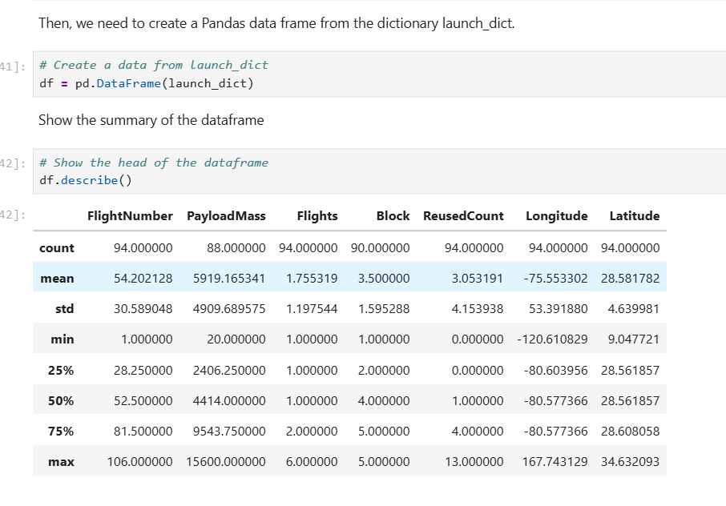
Data Collection – SpaceX API
Data of Falcon 9 was collected by sending a request to the url: https://api.spacexdata.com/v4/launches/past using the requests library and data wrangling has been performed to gain useful insights on the Booster Version Falcon 9
Link for the Notebook : link
Place your flowchart of SpaceX API calls here

Slide 9
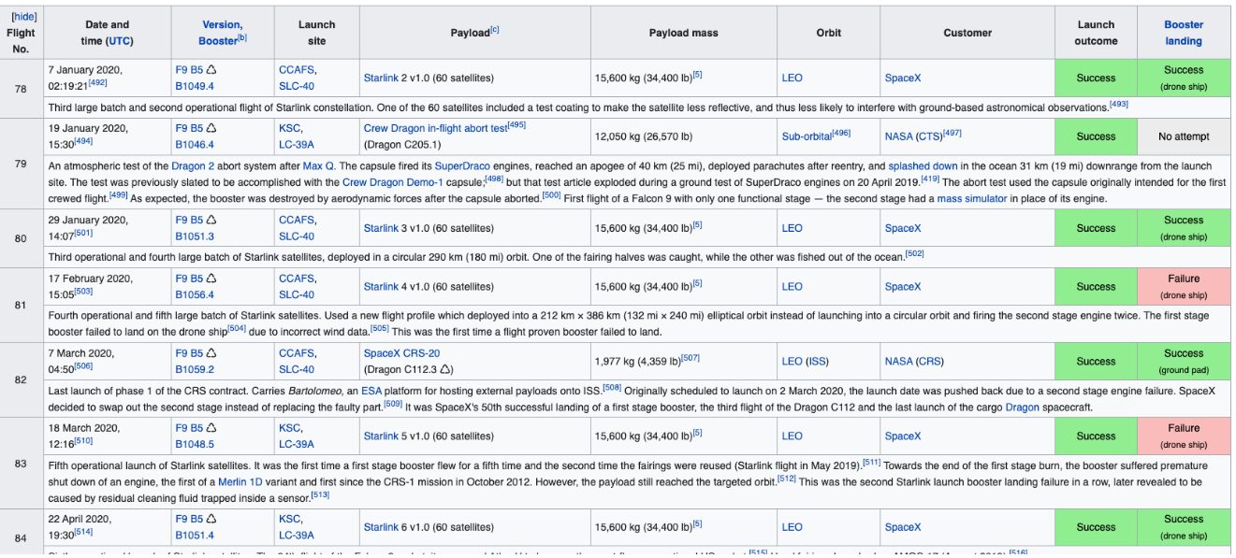
Data Collection - Scraping
Scraped Wikipedia Page using Beautiful Soup and requests library and Parsed to a Data Frame for further analysis.
Link of the Notebook: link
Place your flowchart of web scraping here

Slide 10
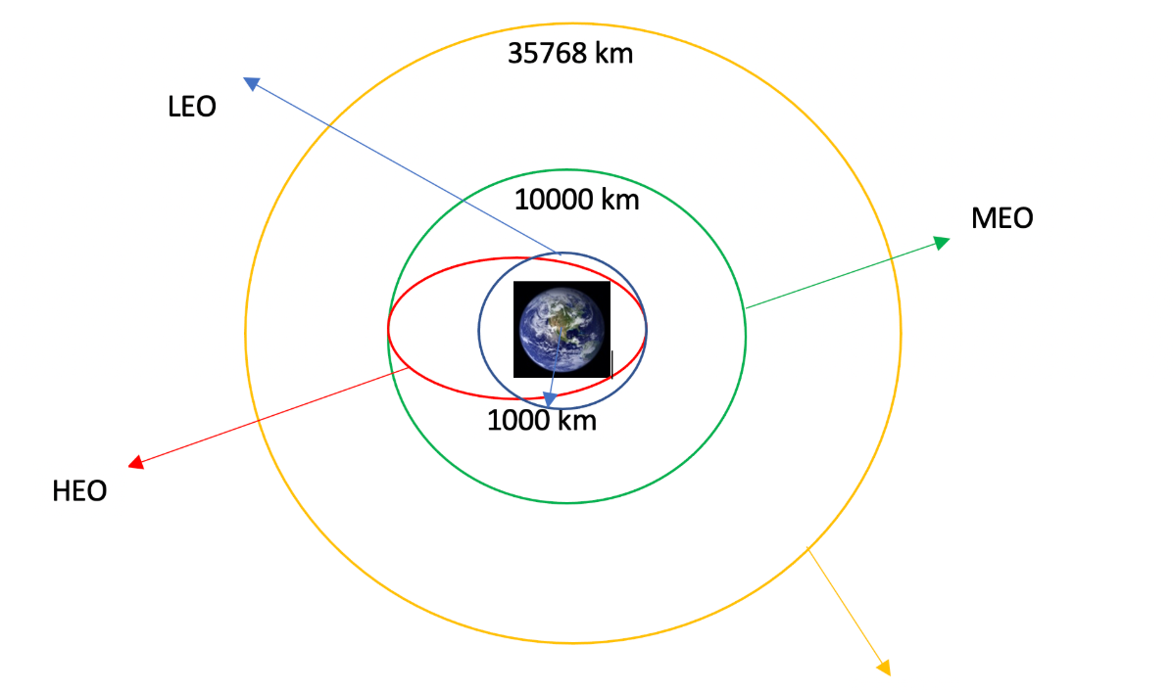
Data Wrangling
Performed Exploratory Data Analysis to identify patterns in SpaceX launch Data.
Analyzed different landing outcomes and frequency of rockets launched to each particular orbit
Converted the landing outcomes to a numerical approach, preparing the dataset for the supervised machine learning model.
Link of the Notebook: link

Slide 11
EDA with Data Visualization
The relationships between the outcome of the first part of the rocket being reused and Payload Mass, Flight Number, Orbit launched to, Launch site was observed and taken into consideration before proceeding with the training Also, the average success rate each year for the reuse of Falcon 9 has also been observed
Category plot, Scatter plot, Bar charts, Line charts were used for this purpose
Link of the Notebook and graphs : link

Slide 12
EDA with SQL
Performed Analysis on the csv file by converting it to a database in SQL. Found details and relationships regarding Payload, BoosterVersion, Launch site, Orbit.
The names of unique launch sites in the space mission.
The total payload mass carried by boosters launched by NASA (CRS)
The average payload mass carried by booster version F9 v1.1
The total number of successful and failure mission outcomes
The failed landing outcomes in drone ship, their booster version and launch site names.
Link of Notebook: link

Slide 13
Build an Interactive Map with Folium
Performed geospatial analysis on SpaceX launch data using Folium maps. Visualized launch outcomes with color-coded markers to identify launch sites with higher success rates.
Encoded launch outcomes into binary classes (0 for failure, 1 for success) for machine learning.
Answered the questions:
Are launch sites in close proximity to railways, highways and coastlines for better transport accessibility?
Are the launch sites located at a safe distance from cities ?
Link of Notebook: link

Slide 14
Build a Dashboard with Plotly Dash
Built an Interactive Dashboard using Plotly Dash consisting of Pie Charts and Category Plots to answer the questions
- Which launch site to launch from to expect a successful launch ?
- What is the payload range to use maximize the chances of reusing the first part of the - rocket ?
- Which version has the highest success rate of launching ?
Link of python file: link

Slide 15
Predictive Analysis (Classification)
The data is separated into training data and testing data to estimate the model’s performance in unseen data.
Classification Algorithms like KNN, SVM, Decision Trees were used to train the model
GridSearchCV was used to train and optimize the models with various combinations of parameters and hyper parameters.
The model’s performance was estimated on test data using metrics like accuracy score, confusion matrix, F1 score, Precision, Recall, Support
Link of Notebook : link

Slide 16
Results
Exploratory data analysis results
Interactive analytics demo in screenshots
Predictive analysis results

Slide 17

Section 2

Slide 18

Flight Number vs. Launch Site
Category plot between Flight Number and Launch Site shows that CCAFS SLC-40 is used frequently than other launch sites where the least used one being VAFB SLC-4E

Slide 19
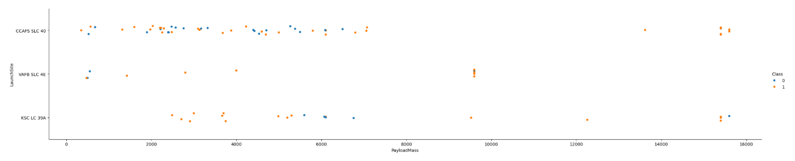
Payload vs. Launch Site
Category plot between Payload and Launch Site shows that
VAFB-SLC launch site there are no rockets launched for heavy payload mass(greater than 10000).
5000 – 7000 kg of Payload had the least success rate among other mass of payload.

Slide 20
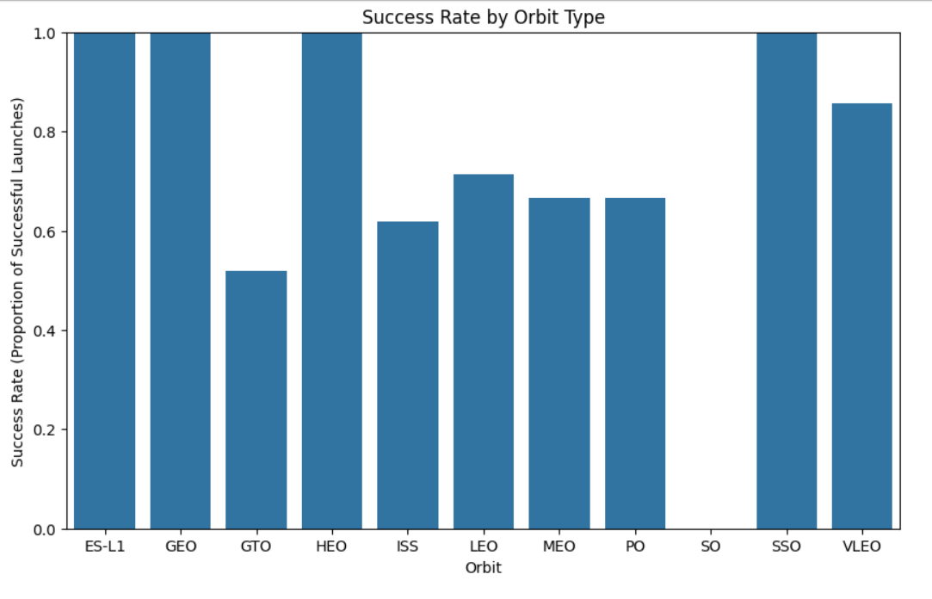
Success Rate vs. Orbit Type
Bar Graph between Success vs Orbit Type shows that
ES–L1, GEO, HEO, SSO, VLEO were the orbits to which the launches were always successful.
GTO, ISS, LEO, MEO, PO, VLEO are the orbits to which the launches had both success and failures
SO is the only orbit which has faced only failures

Slide 21
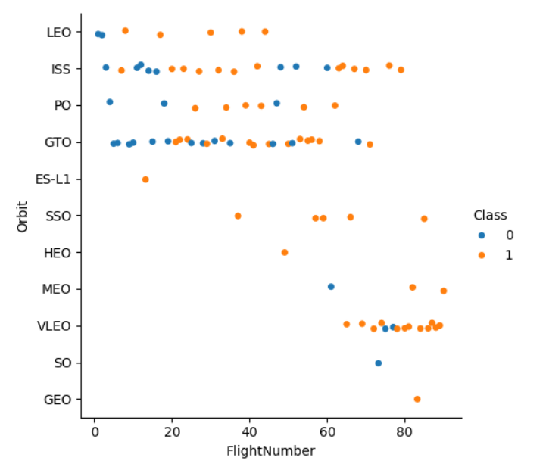
Flight Number vs. Orbit Type
Categorical plot between Flight Number vs Orbit shows that
LEO orbit, success seems to be related to the number of flights.
GTO orbit, there appears to be no relationship between flight number and success.
SSO orbit, had only success for all the launched flight numbers

Slide 22
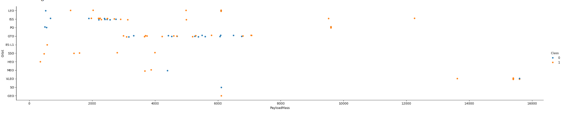
Payload vs. Orbit Type
Categorical plot between Payload vs Orbit Type shows that
With heavy payloads the successful landing or positive landing rate are more for Polar, LEO and ISS.
However, for GTO, it's difficult to distinguish between successful and unsuccessful landings as both outcomes are present

Slide 23
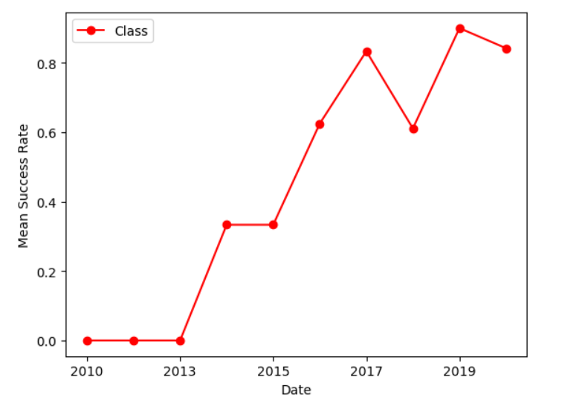
Launch Success Yearly Trend
Line chart between Success Yearly Trend shows that
Success rate since 2013 kept increasing till 2020 with a slight dip in 2019

Slide 24
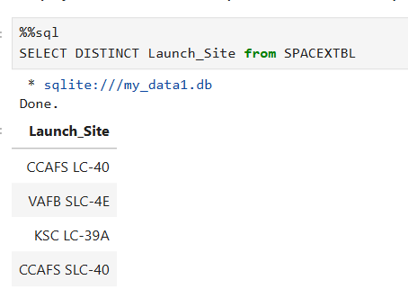
All Launch Site Names
The Launch sites were accessed using the keyword DISTINCT.

Slide 25
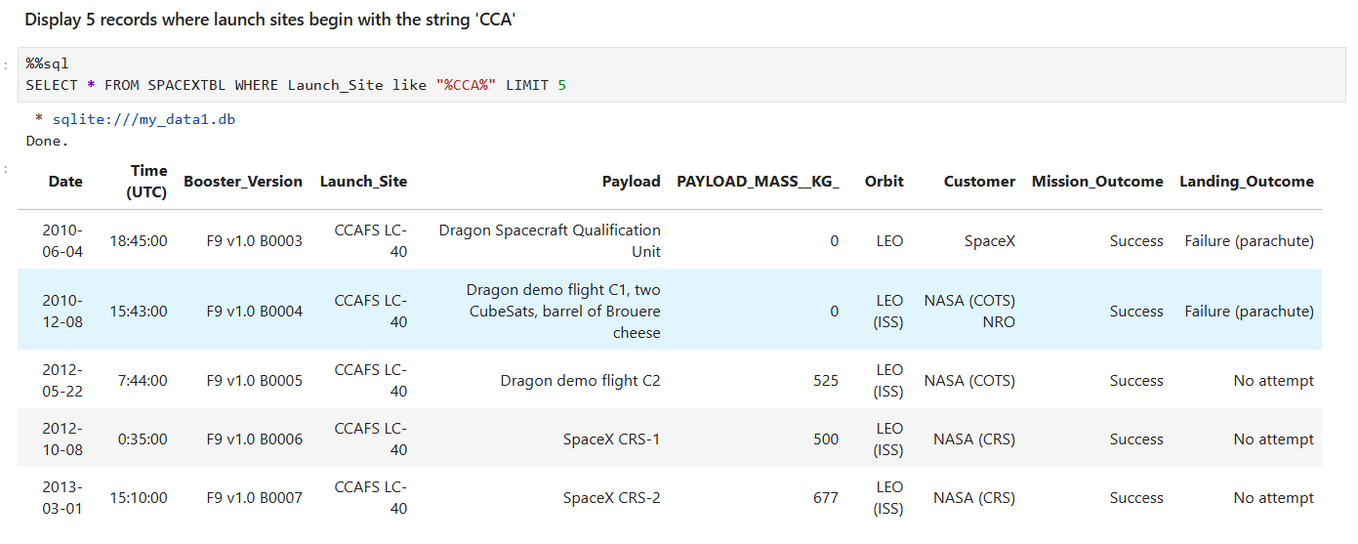
Launch Site Names Begin with 'CCA'
The query to get the launch sites that begin with CCA used the keyword LIKE and wildcard % and also the keyword LIMIT.

Slide 26
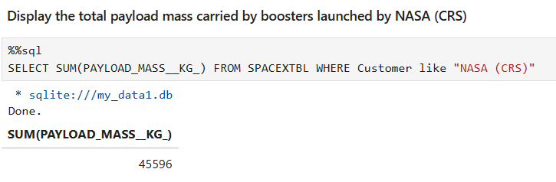
Total Payload Mass
The query to Total Payload Mass has used the keyword WHERE, LIKE to specify the condition and SUM to compute sum of the payload mass.

Slide 27
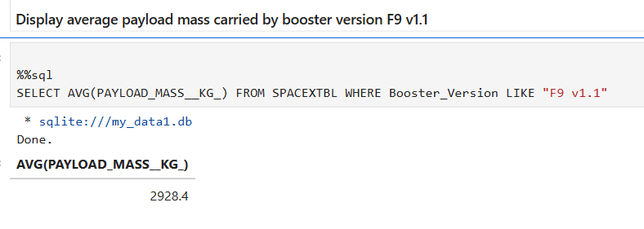
Average Payload Mass by F9 v1.1
The query to Average Payload Mass by F9 v1.1 has the keywords WHERE, LIKE to specify the condition and AVG to compute the average of the payload mass.

Slide 28
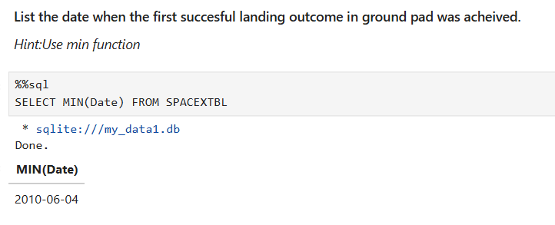
First Successful Ground Landing Date
The query to First Successful Ground Landing Date has used the MIN function to compute the “minimum” date.

Slide 29
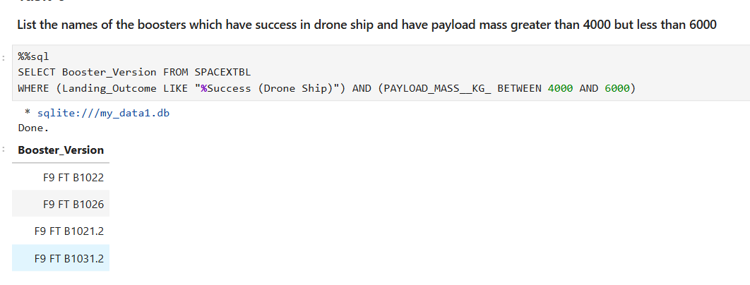
Successful Drone Ship Landing with Payload between 4000 and 6000
The query has used two conditions, the first one, boosters with Success in landing on Drone ship and the second one, to get data of payload mass being in the range of 4000 to 6000 kg.

Slide 30
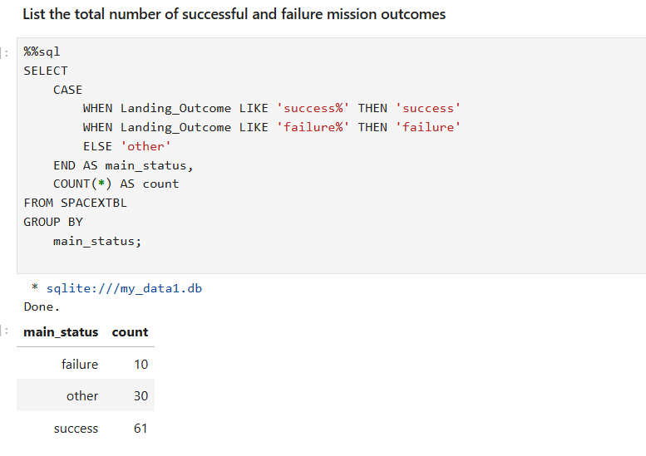
Total Number of Successful and Failure Mission Outcomes
The query includes the use of the keyword CASE and END to specify the condition which is passed to the GROUP BY keyword to group the data and display.

Slide 31
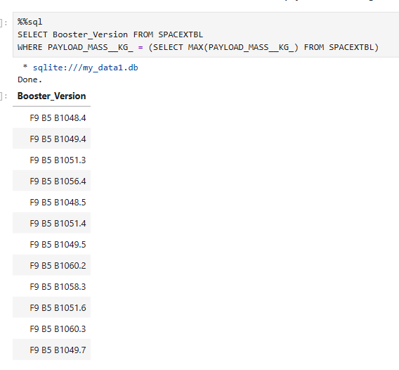
Boosters Carried Maximum Payload
The query involves the use of a subquery to compute the maximum payload mass which is given as a value of payload mass in the WHERE clause, thereby completing the condition on which the data is being extracted.

Slide 32
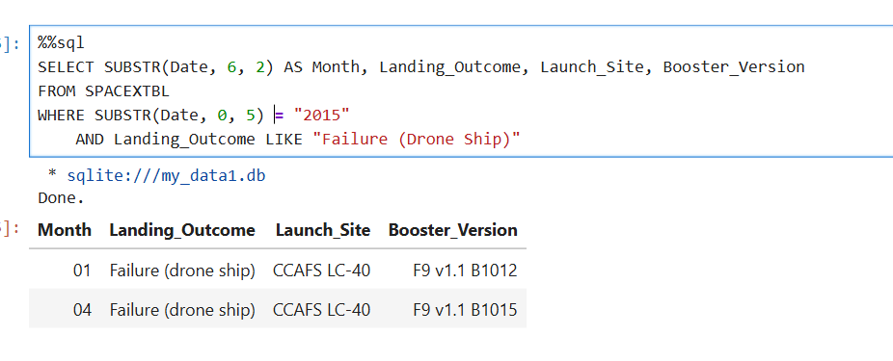
2015 Launch Records
The query to display “List the records which will display the month names, failure landing outcomes in drone ship ,booster versions, launch site for the months in year 2015” as given in the notebook involved the use of SUBSTR keyword to extract the date and year from the data.

Slide 33
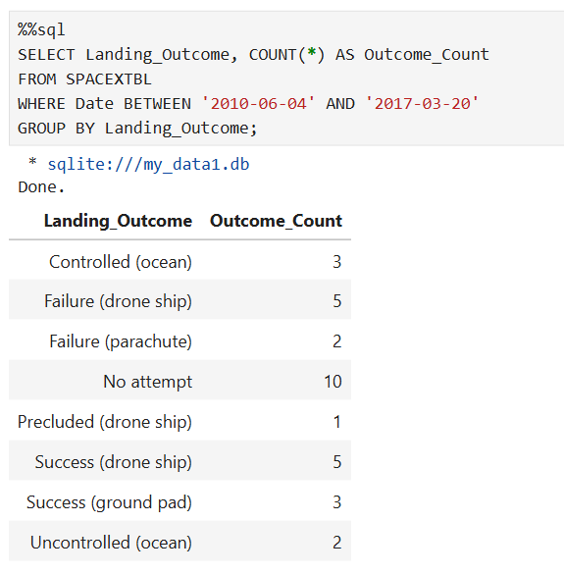
Rank Landing Outcomes Between 2010-06-04 and 2017-03-20
The query involved the use of BETWEEN and AND keywords to specify the condition and GROUP BY is used to group the computed findings based on their landing outcome.

Slide 34

Section 3

Slide 35
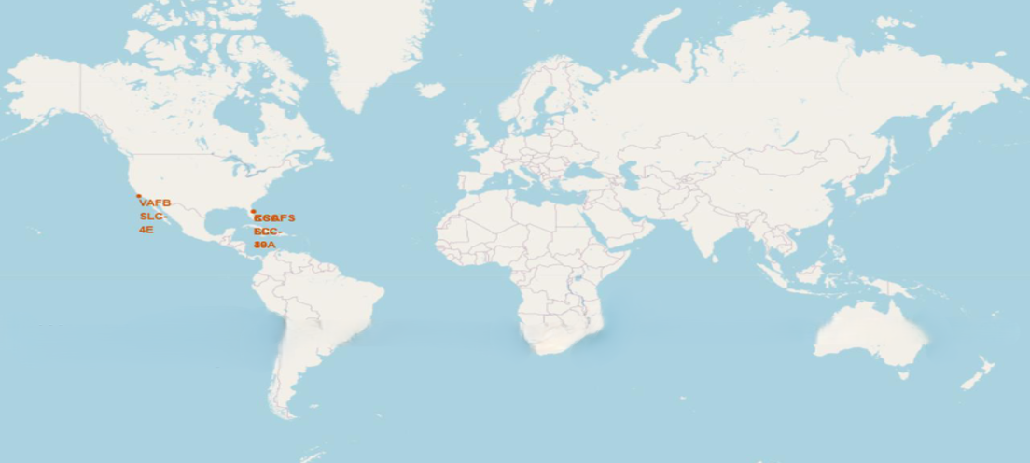
Launching Sites of SpaceX rockets
The world map shows the different locations of the launching sites for the SpaceX rockets,
These are located in the USA.

Slide 36
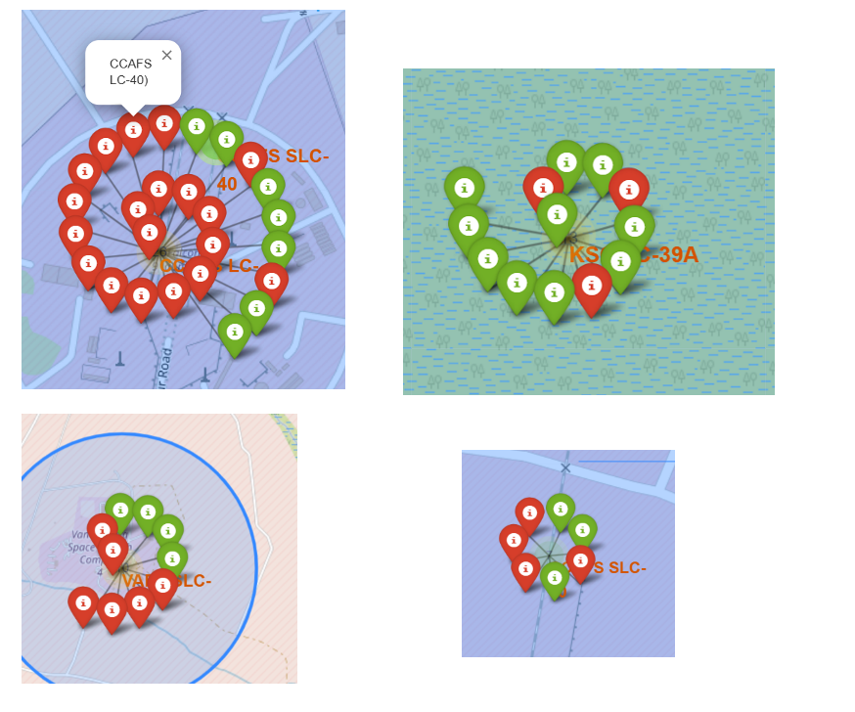
Markers of Launch sites shown with color
The Successful Launches are marked by Green and the Failed Launches are Marked by Red.

Slide 37
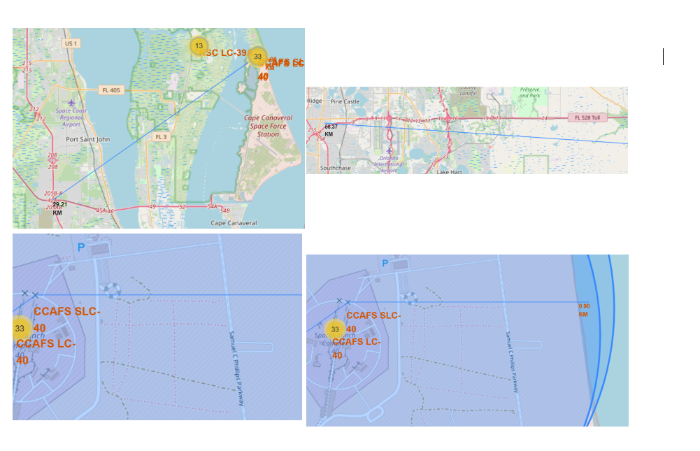
Distances between the nearest highway, coast, city
The distances to the nearest coast line, highway and city are shown in the map
The launching stations are located closer to the ocean
They are located farther away from ocean and highways

Slide 38

Section 4

Slide 39
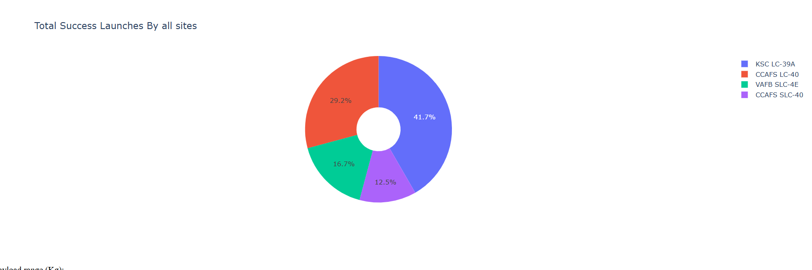
Total Success Launches by all Sites
The Launch Location KSC LC- 39A has over 40% of all the Successful Launches

Slide 40
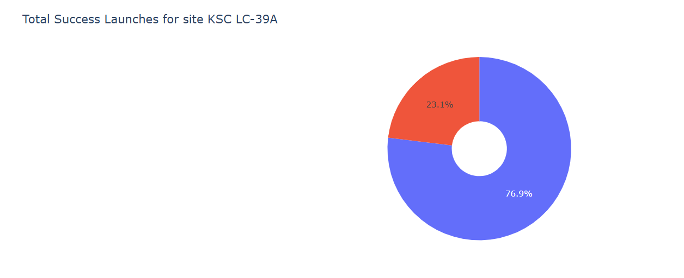
Pie chart depicting Success vs Failure for the Launch Location KSC LC-39A
The location KSC LC 39A has the highest Success to Failure Ratio among all the other launches

Slide 41
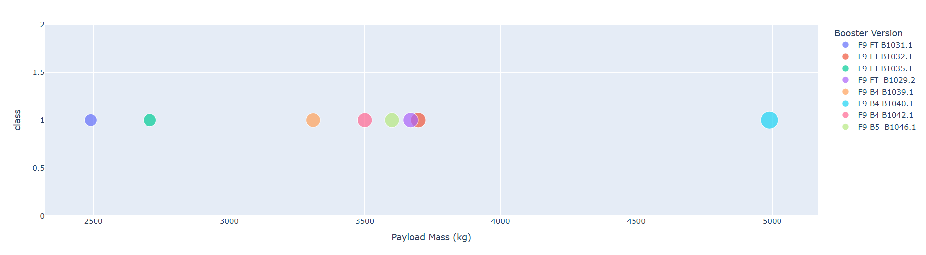
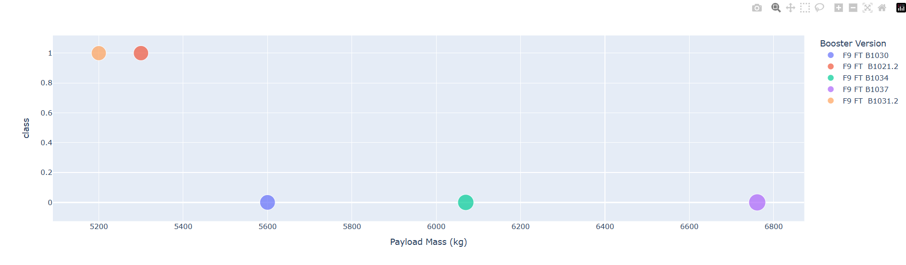
Scatter plot of Payload vs Launch Outcome for all the locations with different payload ranges
Range slider between 0 – 5000 kg of Payload
Range slider between 5000 – 10000 kg of Payload

Slide 42

Section 5

Slide 43
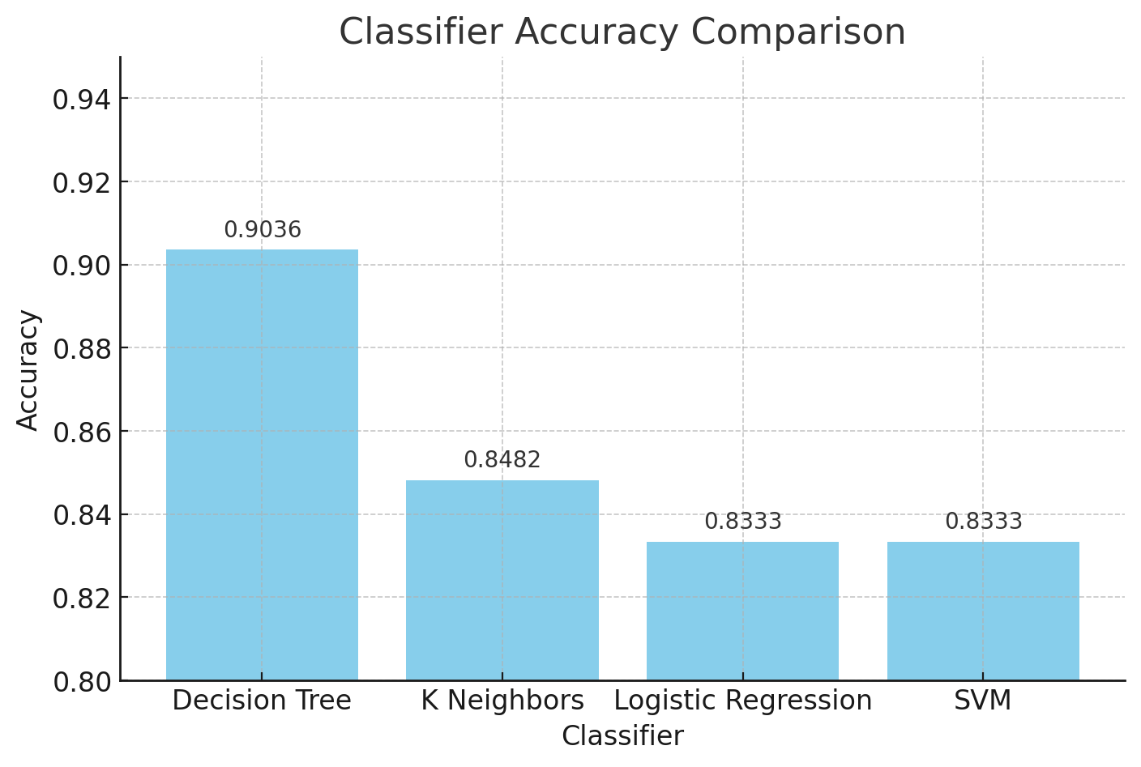
Classification Accuracy
Looking at the Bar Chart, Decision Tree has the highest accuracy of 0.9036
its parameters include
criterion : gini
max_depth : 2
max_features : sqrt
min_samples_leaf : 1
min_samples_split: 5
splitter: random

Slide 44
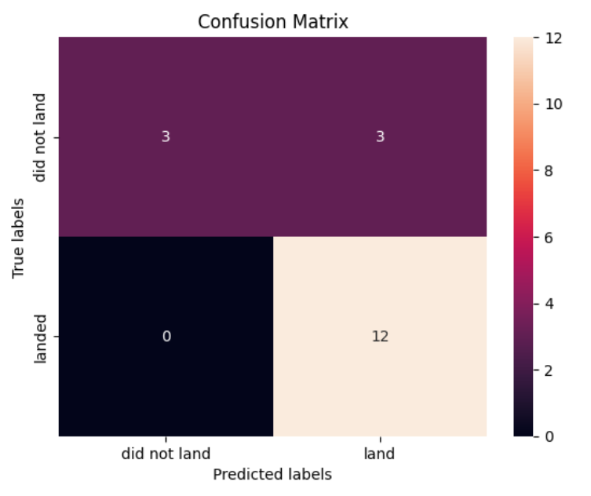
Confusion Matrix
The confusion matrix of the Decision Tree Classifier reveals that the model achieved perfect prediction accuracy for all instances where the rocket successfully landed. However, the model demonstrates limitations in predicting unsuccessful landings, misclassifying approximately 50% of these cases as successful landings. This indicates a bias towards predicting positive outcomes.

Slide 45

Data Analysis Conclusions
What factors decide if the rocket will land successfully and will SpaceX reuse the first part of the rocket in a launch?
Launch Location, KSC LC-39A has the highest success to failure ratio.
Orbit launched to, Orbits ES-L1, GEO, HEO, SSO, VLEO had the most success rate.
Booster Version Used
Payload Weight Carried
Can a Machine Learning Model predict the whether SpaceX’s Falcon 9 first stage will land and be reused based on publicly available launch data?
Yes, A Decision Tree Classifier can predict whether first stage will land or not with 90 percent accuracy.
Are there any patterns in SpaceX launches over time?
Yes, the Success of SpaceX rockets have increased almost continuously from 2013 to 2020

Slide 46
Appendix
The code/graph/notebooks that have been created during the preparation of this presentation is available on this link.

Slide 47


